Slide 1

Bluetooth Low Energy (BLE)

Slide 2
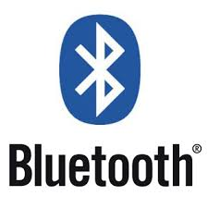
Bluetooth “classic”
The “conventional” Bluetooth
2.4GHz
Range: 1m - 100m (10m typical)
Connection-oriented: audio, file transfer, networking
Reasonably fast data rate: 2.1 Mbps
Power consumption:
< Wifi < 3G

Slide 3

Bluetooth Low Energy
"Bluetooth Smart“
Light-weight subset of classic Bluetooth
Operates in same freq. Range
introduced as part of the Bluetooth 4.0 core specification
Started by Nokia as an in-house project called “Wibree”
Target Apps:
Wireless battery-powered sensors eg. heart rate, thermometer, wearables
Low bandwith
No always on, constrained devices

Slide 4
BLE Applications

Slide 5
Bluetooth Classifications
Bluetooth Classic
high throughput, e.g. wireless audio and file transmission.
Bluetooth Smart
State information
Devices with low-duty cycles
Bluetooth SmartReady
These devices are essentially the “hub” devices such as computers, smartphones, etc. They support both the “classic” and “smart” devices, just as our smartphones can connect to a Bluetooth speaker to transmit audio and also communicate to a fitness tracker.

Slide 6
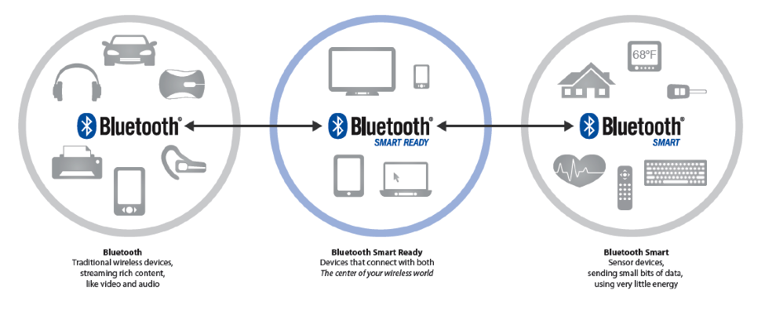
Bluetooth family

Slide 7
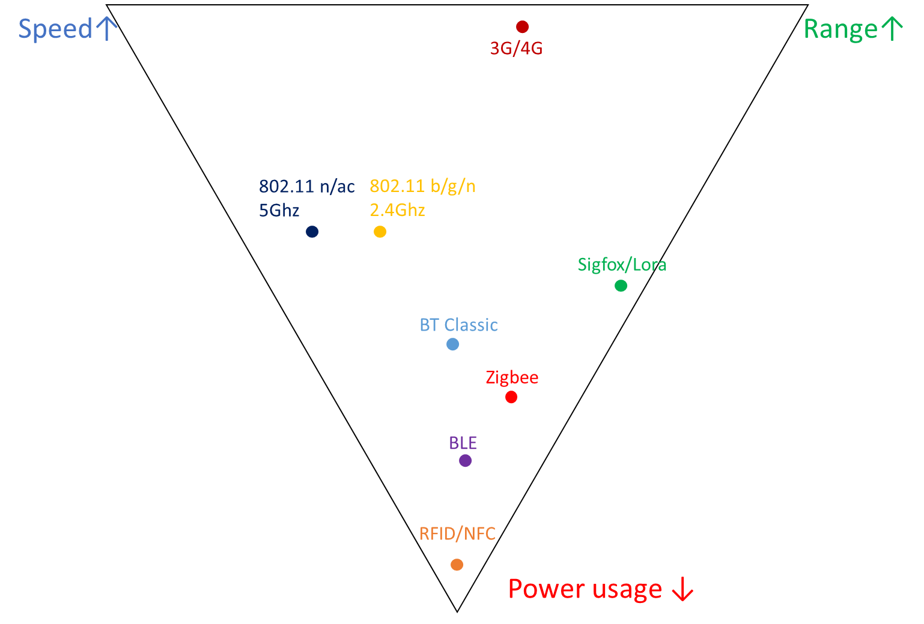
Wireless Technologies Comparison

Slide 8
BLE vs Classic
Bluetooth and Bluetooth Low Energy are used for different purposes
Bluetooth Classic
can handle a lot of data
consumes battery quickly
BLE
used for applications that do not need to exchange large amounts of data
cheap
Marginally further range

Slide 9
BLE Platform Support
Bluetooth 4.0 + (and Bluetooth Low Energy) is available on most major platforms:
iOS5+
Android 4.3+
Apple OS X 10.6+
Windows 8 +
GNU/Linux Vanilla BlueZ 4.93+

Slide 10
GAP and GAT for BLE
Generic Access Profile (GAP) or Advertising
Information advertised to central before connection
Name of peripheral
Is it connectable?
Supported features (services)
Generic Attribute Profile (GATT)
How to exchange data once connected
Identifies Services, Characteristics and Descriptors

Slide 11
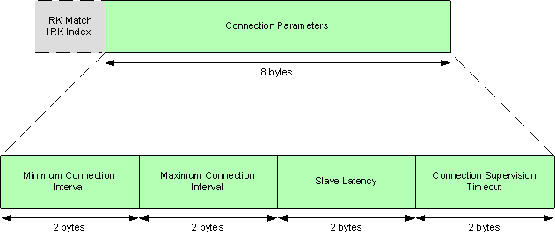
Generic Access Profile (GAP)
GAP responsible for “device visibility.”
Determines how two devices can (or can't) interact with each other.

Slide 12
GAP Device Roles
GAP defines 2 roles for devices:
Central
Peripheral
Peripheral devices are small, low power, resource constrained devices
Connect to a powerful central device.
Central devices are usually far more processing power and memory.
Tablet, Mobile phone, laptop

Slide 13
GAP - Advertising and Scan Response Data
2 ways for a device to advertise with GAP
Advertising Data payload
Scan Response payload.
Advertising data payload is mandatory
Scan response payload is optional
allows device designers to fit more information in the advertising payload such a strings for a device name, etc.
Advertising Process

Slide 14
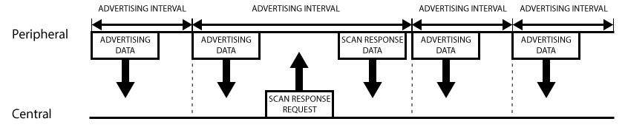
Advertising process
Peripheral sets a specific advertising interval and transmit advertising packet
longer delays saves power but less responsive
A listening device interested in the scan response payload can optionally request the scan response payload, and the peripheral will respond with the additional data.

Slide 15
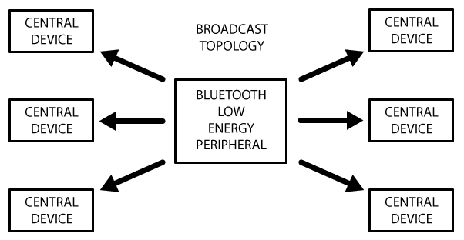
Broadcast Network Topology
Some devices/apps only require advertise data.
E.g. app requires peripheral to send data to more than one device at a time.
Can include small amount of custom data in 31 byte advertising or scan response payloads.
In this way, BLE peripheral can send data one-way to any devices in listening range

Slide 16
Bluetooth Connection
Establishing a connection between a peripheral and a central device results in 1 to 1 communiction
the advertising process will stop
no longer be able to send advertising packets
Communiction in both directions
Must use GATT services and characteristics to communicate

Slide 17
Generic Attribute Profile - GATT
Defines the way that two Bluetooth Low Energy devices transfer data back and forth
Uses Services and Characteristics.
With GATT, a BLE peripheral can only be connected to one central device (e.g. a mobile phone, etc.)

Slide 18
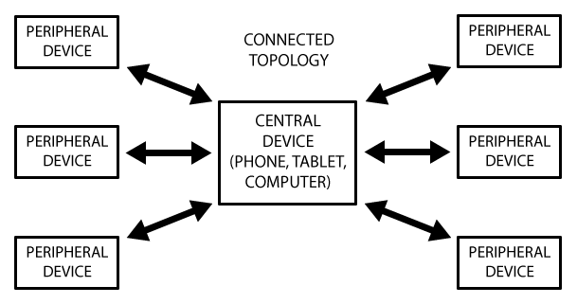
BLE Network Topology
A peripheral can only be connected to one central device
Ccommunication is 2 -way
Central device can be connected to multiple peripherals.
If data needs to be exchanged between two peripherals, a custom messaging system will need to be implemented
all messages pass through the central device.

Slide 19
GATT transactions
Follows a (strange) client server relationship
Peripheral is known as the GATT Server
The GATT Client (the phone/tablet), which sends requests to this server.
Follows master/slave approach
All transactions are started by the master device, the GATT Client
GATT client receives response from the slave device, the GATT Server.
Peripheral will suggest a 'Connection Interval' to the central device, and the central device will try to reconnect every connection interval to see if any new data is available,

Slide 20
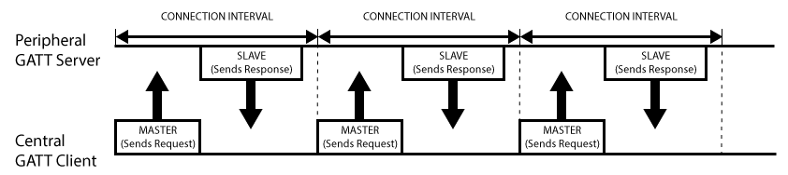
GATT Transactions

Slide 21
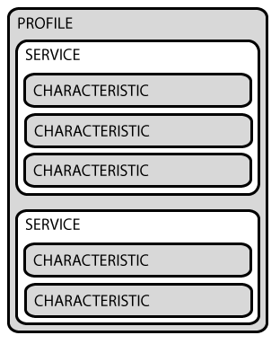
GATT – Services and Characteristics
GATT transactions are based on Profiles, Services and Characteristics

Slide 22
GATT Profile
A pre-defined collection of Services that has been compiled by either the Bluetooth Special Interest Group or by the peripheral designers.
E.g. The Heart Rate Profile
combines the Heart Rate Service and the Device Information Service.
Complete list of GATT-based profiles can be found here: Profiles Overview

Slide 23
GATT Services
Breaks data up into logic entities
Contain one or more characteristics
Each service distinguished by unique numeric ID called a UUID
16 bit
Set of officially adopted BLE services can be seen on the Services
E.g. official Heart rate service
service has a 16-bit UUID of 0x180D
contains up to 3 characteristic
Heart Rate Measurement, Body Sensor Location and Heart Rate Control Point.

Slide 24
GATT Characteristics
Represents a single data point
Similarly to Services, each Characteristic distinguishes itself via a pre-defined UUID
Also use standard characteristics defined by the Bluetooth SIG
E.G Heart Rate:
the Heart Rate Measurement characteristic is mandatory for the Heart Rate Service
Heart rate measurement has UUID of 0x2A37
If you write apps that use BLE, characteristics are what you will be after with your BLE peripheral

Slide 25
Sources
https://learn.adafruit.com/introduction-to-bluetooth-low-energy/gatt
https://www.bluetooth.com/specifications

